Slide 1
Department of Computer Science ,UIET Kathua
PRESENTATION
ON
“Gesture Control System Using OpenCV”
Submitted By : Under the Guidance of:
Abhishek Gupta(201603001) Er. Archana Salaria
Abhey Sharma (201603002)
Manish Sharma (201603011)
Raghav Khajuria (201603016)

Slide 2
Contents
Introduction
Usage
Modules
Workflow
Classification Algorithm
Classifier Models
Final Output
Future Scope

Slide 3
Introduction:
Hand Gesture Recognition is a technology that enables computers to interpret and understand human hand movements and gestures. This involves capturing, processing, and interpreting hand movements through various computer vision techniques(like webcam). The goal is to enable a seamless interaction between humans and machines without the need for physical devices like a keyboard or mouse.
The concept of interpreting hand movements to convey commands or input has garnered significant attention, finding applications in diverse fields such as gaming, virtual reality, and assistive technologies

Slide 4
p
Usage
Human-Computer Interaction (HCI): The ability to recognize hand gestures in real-time facilitates a natural and intuitive interaction between humans and computers. This can be particularly useful in applications where traditional input devices like keyboards and mice are impractical, such as virtual reality environments or touchless interfaces.
Accessibility: Hand gesture recognition can enhance accessibility for individuals with disabilities. People with limited mobility or certain impairments may find it easier to control and interact with devices through hand gestures, providing an alternative to traditional input methods.

Slide 5
Educational Tools: The project can serve as an educational tool for learning about computer vision, deep learning, and real-time processing. Students and developers can use it as a starting point to understand how to implement gesture recognition systems and customize them for specific use cases.
Training and Simulation: Gesture recognition can be used in training simulations for various fields, such as aviation or military training. Users can interact with simulated environments using hand gestures, providing a more realistic training experience.
Entertainment and Gaming: Gesture recognition can be integrated into gaming consoles and entertainment systems, offering an immersive and interactive experience for users.

Slide 6



Modules

Slide 7
OpenCV: OpenCV is an open source computer vision and machine learning software library. It contains over 2500 algorithms and is used for various applications such as face recognition, object detection, image processing, and more. OpenCV was built to provide a common infrastructure for computer vision applications and to accelerate the use of machine perception in the commercial products.
MediaPipe: MediaPipe is a cross-platform framework for building machine learning solutions for live and streaming media. It is an open source project developed by Google and it supports various applications such as face detection, hand tracking, object detection, and more. You can use MediaPipe to create custom pipelines for processing time-series data like video, audio, and images. MediaPipe also provides pre-trained models and tools for customizing and evaluating your solutions.
TensorFlow: TensorFlow is an open-source platform for creating machine learning and deep learning applications. It was developed by Google and released in 2015. TensorFlow allows you to build and train neural networks using data flow graphs, where nodes represent mathematical operations and edges represent tensors (multidimensional arrays) that flow between them. You can use TensorFlow to solve various problems such as image recognition, natural language processing, recommender systems, and more.

Slide 8
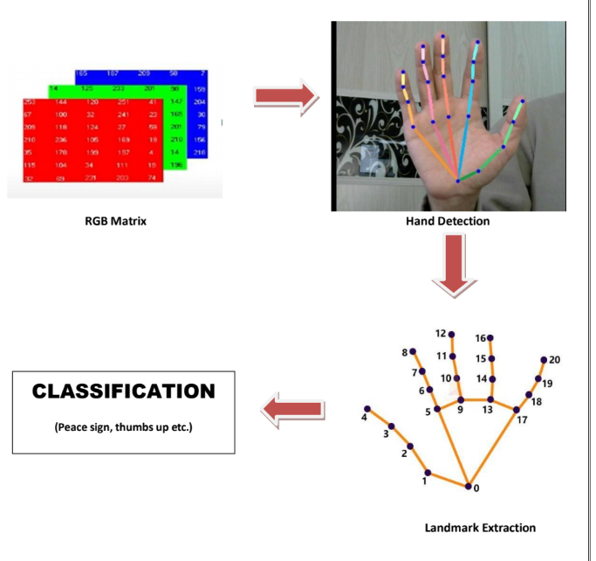
Workflow

Slide 9
Classification Algorithm
CNN: CNN stands for Convolutional Neural Network, which is a type of deep learning algorithm that is particularly well-suited for image recognition and processing tasks. It is made up of multiple layers, including convolutional layers, pooling layers, and fully connected layers. The convolutional layers are the key component of a CNN, where filters are applied to the input image to extract features such as edges, textures, and shapes. The output of the convolutional layers is then passed through pooling layers, which are used to down-sample the feature maps, reducing the spatial dimensions while retaining the most important information.
LSTM: An LSTM model is a type of recurrent neural network (RNN) that can process sequential data, such as text, speech, or time series. LSTM stands for Long Short-Term Memory, which refers to the memory cells and gates that are used to control the flow of information inside the network. LSTM models are able to learn long-term dependencies and avoid the vanishing gradient problem that affects standard RNNs

Slide 10
Classifier Models
KeyPointClassifier: The KeyPointClassifier class is responsible for classifying hand gestures based on the detected landmarks. It loads a pre-trained TensorFlow Lite model (keypoint_classifier.tflite) that takes a list of hand landmarks as input and outputs a classification result. It uses CNN algorithm.
PointHistoryClassification: The PointHistoryClassifier class is responsible for classifying finger gestures based on the historical trajectory of a specific hand landmark (e.g., the tip of the index finger) over several frames. It loads a separate TensorFlow Lite model (point_history_classifier.tflite) for point history classification.

Slide 11
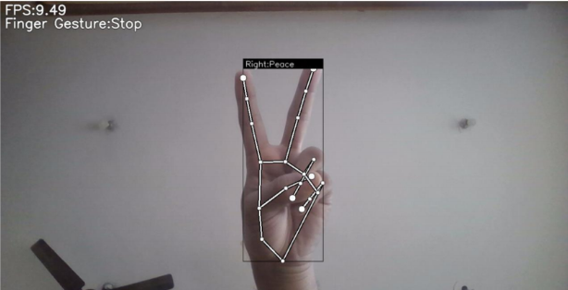
Final Output

Slide 12
Future Scope
We will develop Touchless Navigation System used to perform specific functions like moving slides next, volume up and down or zoom in and zoom out in a device without actually touching the screen or using any device such as keyboard or mouse.
We will define new gestures such as:
Moving slides forward: A swipe gesture to the right.
Moving slides backward: A swipe gesture to the left.
Volume up: A circular motion with the hand in a specific direction.
Volume down: A circular motion in the opposite direction.
Zoom in: A pinch gesture with two fingers.
Zoom out: A spread gesture with two fingers.
We will extend the classification logic with more advancements.

Slide 13

Thank You

